Slide 1

E-r model
Group 4
harmeet 2019UCO1515
KARTIK 2019UCO1516
MAHIMA 2019UCO1517
ASHISH Kumar 2019UCO1518

Slide 2

ENTITY-RELATIONSHIP MODEL
The ER model is very useful in mapping the meanings and interactions of real-world enterprises onto a conceptual schema. Because of this usefulness, many database-design tools draw on concepts from the ER model.

Slide 3
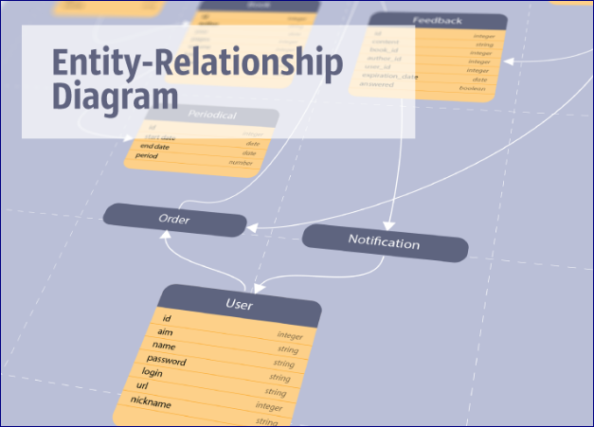
INTRODUCTION
ER Model is used to model the logical view of the system from the data perspective which consists of these components:
Entity set
Relationship set
Attribute
The ER model has an associated diagrammatic representation, the ER diagram, which can express the overall logical structure of a database graphically.

Slide 4
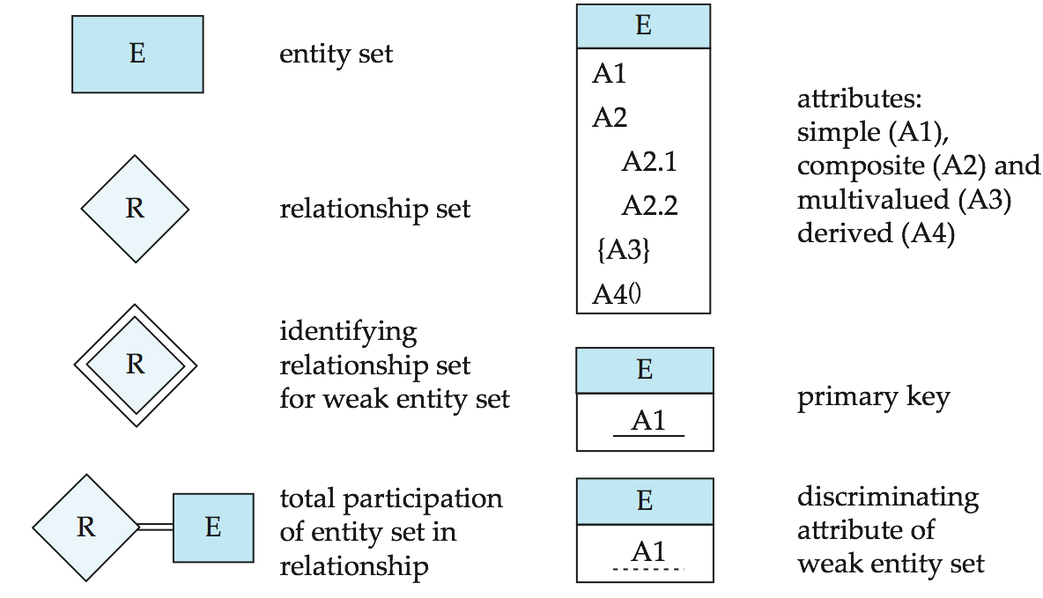
SYMBOLS USED IN ER DIAGRAMS

Slide 5
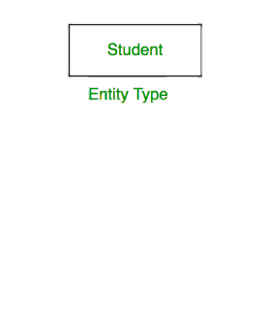
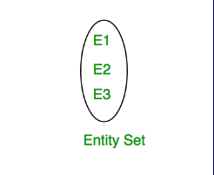
Entity set
An Entity may be an object with a physical existence - a particular person, car, house, or employee - or it may be an object with a conceptual existence - a company, a job, or a university course.
An Entity is an object of Entity Type and set of all entities is called as Entity Set. e.g.; E1 is an entity having Entity Type Student and set of all students is called Entity Set.

Slide 6
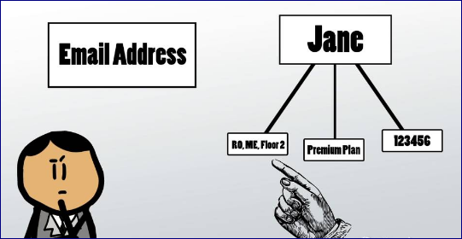
attributes
Attributes are the properties which define the entity type.
For example, Roll_No, Name, DOB, Age, Address, Mobile_No are the attributes which defines entity type Student.
In ER diagram, attribute is represented by an oval

Slide 7

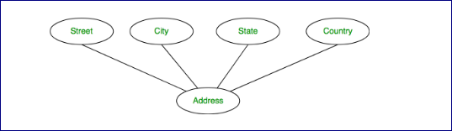
Attributes Types
Key Attribute
Composite Attribute
The attribute which uniquely identifies each entity in the entity set is called key attribute.For example, Roll_No will be unique for each student.
An attribute composed of many other attribute is called as composite attribute. For example, Address attribute of student Entity type consists of Street, City, State, and Country.
Types of attributes are :
Key attribute
Composite attribute
Multivalued attribute
Derived Attribute
In ER diagram, key attribute is represented by an oval with underlying lines.
In ER diagram, composite attribute is represented by an oval comprising of ovals.

Slide 8
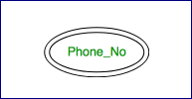

Attributes Types
Multi-valued Attribute
Derived Attribute
Types of attributes are :
Key attribute
Composite attribute
Multivalued attribute
Derived Attribute
An attribute consisting more than one value for a given entity. For example, Phone_No (can be more than one for a given student).
An attribute which can be derived from other attributes of the entity type is known as derived attribute. e.g.; Age (can be derived from DOB).
In ER diagram, multivalued attribute is represented by double oval.
In ER diagram, derived attribute is represented by dashed oval.

Slide 9
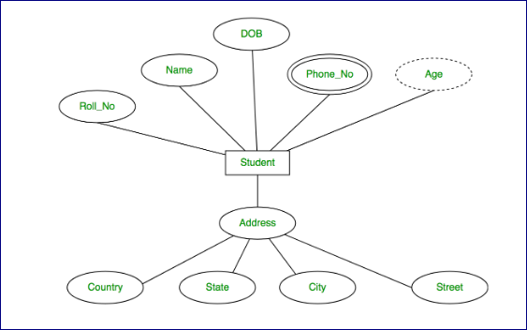
The complete entity type Student with its attributes can be represented as:

Slide 10
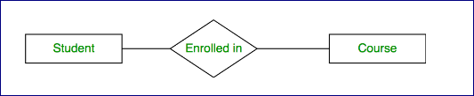
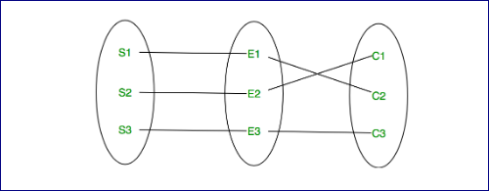
Relationship set
A relationship type represents the association between entity types. For example, ‘Enrolled in’ is a relationship type that exists between entity type Student and Course.
In ER diagram, relationship type is represented by a diamond and connecting the entities with lines.
A set of relationships of the same type is known as a relationship set. The following relationship set depicts S1 is enrolled in C2, S2 is enrolled in C1 and S3 is enrolled in C3

Slide 11
Degree of a relationship set:
The number of different entity sets participating in a relationship set is called as degree of a relationship set.
Unary Relationship
Binary Relationship
n-ary Relationship

Slide 12
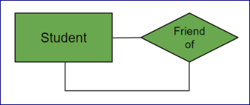
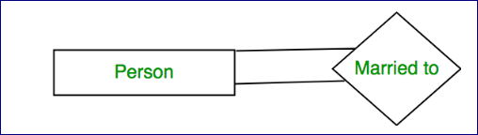
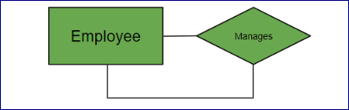
Unary Relationship
When there is only ONE entity set participating in a relation, the relationship is called as unary relationship.
Example 1: A student is a friend of itself.
Example 2: A person is married to a person.
Example 3: An employee manages an employee

Slide 13



Binary Relationship
When there are TWO entities set participating in a relation, the relationship is called as binary .
Example 1: A student attends a course.
Example 2: A supplier supplies item.
Example 3: A Professor teaches subject.

Slide 14
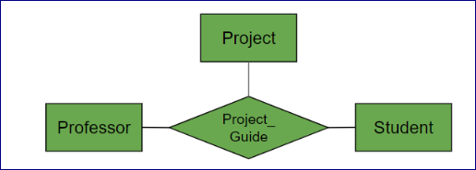
n-ary Relationship
When there are n entities set participating in a relation, the relationship is called as n-ary relationship.
Example: A Professor, student and Project is related to a Project_Guide.

Slide 15
Cardinality
The number of times an entity of an entity set participates in a relationship set is known as cardinality.
Cardinality can be of different types:
One to One
One to Many
Many to Many

Slide 16
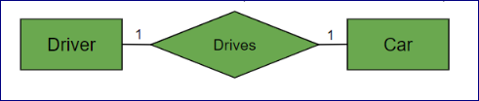


One to One
When each entity in each entity set can take part only once in the relationship, the cardinality is one to one.
Example 1: Let us assume that a driver can drive one car and a cat can be driven by the same driver. So the relationship will be one to one.
Example 2: A person can have only one Aadhar card and one Aadhar card can belong to only one person.
Example 3: Let us assume that a male can marry to one female and a female can marry to one male. So the relationship will be one to one.

Slide 17



One to Many
When entities in one entity set can take part only once in the relationship set and entities in other entity sets can take part more than once in the relationship set, cardinalities is one to many. Many to one also come under this category.
Example 1: A professor teaching many courses
Example 2: Many employees working for one department.
Example 3: Let us assume that a student can take only one course but one course can be taken by many students. So the cardinality will be n to 1. It means that for one course there can be n students but for one student, there will be only one course.

Slide 18


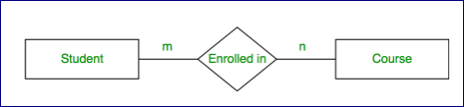
Many to many
When entities in all entity sets can take part more than once in the relationship cardinality is many to many.
Example 1: Any number of student can take any number of subjects.
Example 2: Any number of customer can order any number of products.
Example 3: Let us assume that a student can take more than one course and one course can be taken by many students. So the relationship will be many to many.

Slide 19
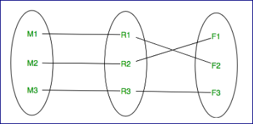
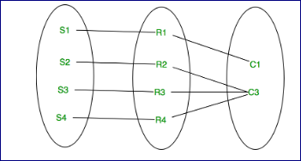
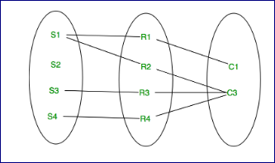
Using set ,cardinality can be expressed as :
One to one mapping
One to many mapping
Many to many mapping

Slide 20
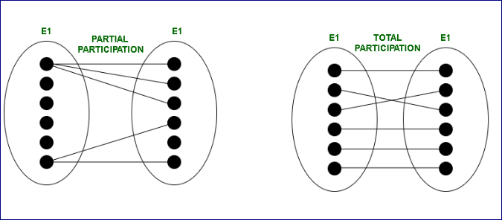
Participation Constraint:
Participation Constraint is applied on the entity participating in the relationship set.
Total Participation
Partial Participation

Slide 21


Total Participation
Each entity in the entity set must participate in the relationship
Example 1: If each student must attend a course, the participation of student will be total. Total participation is shown by double line in ER diagram.
Example 2: Each employee must join a department.

Slide 22

Partial Participation
The entity in the entity set may or may NOT participate in the relationship. If some courses are not enrolled by any of the student, the participation of course will be partial.
EXAMpLE: The diagram depicts the ‘Enrolled in’ relationship set with Student Entity set having total participation and Course Entity set having partial participation

Slide 23
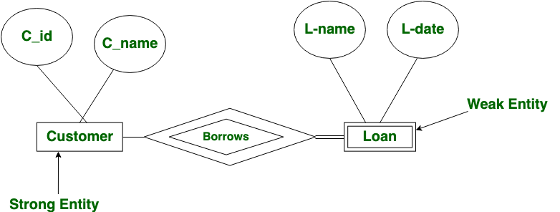
STRONG AND WEAK ENTITY TYPE
A weak entity set is one whose existence is dependent on another entity called identifying entity.
Identifying entity, along with extra attributes called discriminator are used to uniquely identify a weak entity.
An entity set that is not a weak entity set is termed a strong entity set.
The participation of a weak entity type is always total.
The relationship between a weak entity type and its identifying strong entity type is called an identifying relationship and it is represented by a double diamond.

Slide 24
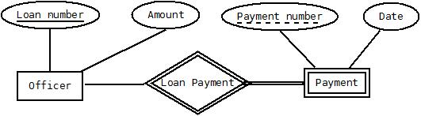
EXAMPLE
In this example, ‘Payment’ is the weak entity. ‘Loan Payment’ is the identifying relationship and ‘Officer’ is the identifying entity. ‘Payment Number’ is the partial key. Primary Key of the Loan along with the partial key would be used to identify the records.
Since payment cant be made without the existence of officer, it is weak entity and it is “existence dependent” on the strong “Officer” entity.

Slide 25

Thank You

